Slide 1
What do you think of when you think of the word “chemistry?”
What do you think we’re going to learn about chemistry?

Slide 2
What is matter?
Matter is anything that has mass and volume. It can be a solid, liquid, or gas.

Slide 3
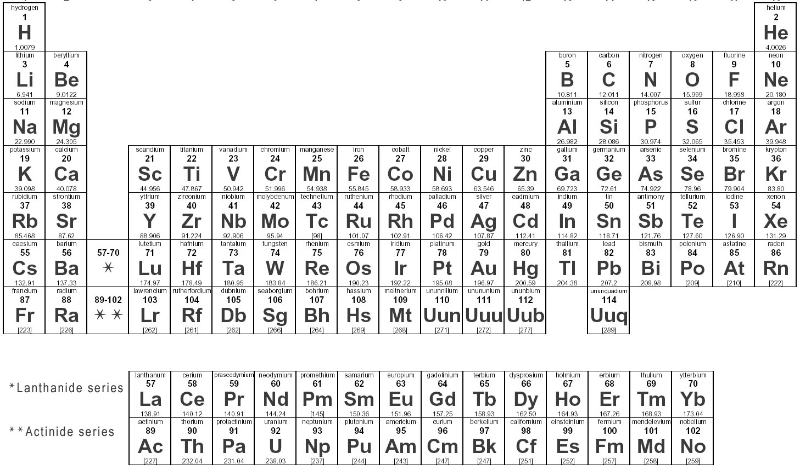
What is an element?
A substance that is made of atoms of the same type. Each element is made of a different type of atom. There are over 100 known naturally occurring elements.

Slide 4
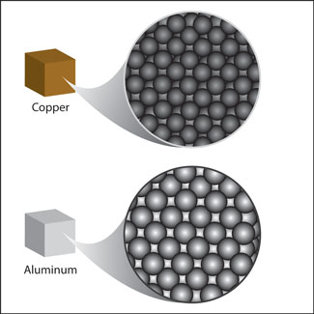
What is an atom?
The smallest particle that makes up any type of element. All matter is made of atoms. Atoms are very very small.

Slide 5
What makes up an atom?
An atom is made up of 3 charged particles:
Protons—have a positive (+) charge
Neutrons—have no (o) charge (think: neutral)
Electrons—have a negative (-) charge

Slide 6
How do charged particles interact?
Particles with the same type of charge repel each other—they push away from each other. Particles with different/opposite charges attract each other—they are drawn toward one another. (This is where the saying “opposites attract” came from.)

Slide 7
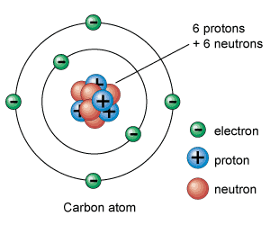
What is the structure of an atom?
The protons and neutrons are grouped together in the center of the atom.
The center of the atom is called the nucleus.
Electrons move around outside the nucleus in what we call an electron cloud.
The nucleus has an overall positive charge (because it contains protons).
The electron cloud has a negative charge (because it contains electrons).

Slide 8
What is the relationship between a proton and a neutron?
A neutron has about the same mass as a proton. They are grouped together in the nucleus.
How big is an atom?
Atoms are extremely small. The electron cloud is about 10,000 times the size of the nucleus.

Slide 9
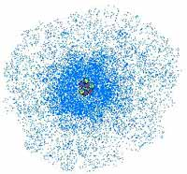
What is special about electrons?
Electrons are much smaller than protons (2000 times smaller).
Electrons move around the nucleus very quickly. Scientists have found that it is not possible to determine the exact position of any single electron in an atom because they are moving too fast. This is why we picture electrons as a cloud around the nucleus.

Slide 10
How do atoms stay together?
Atoms do not have a shell or anything else separating them from the rest of the world. The negatively charged electrons are attracted to the positively charged protons. However, electrical charges that are alike (such as two negative charges) repel each other. This is why electrons remain spread out in the electron cloud.

Slide 11
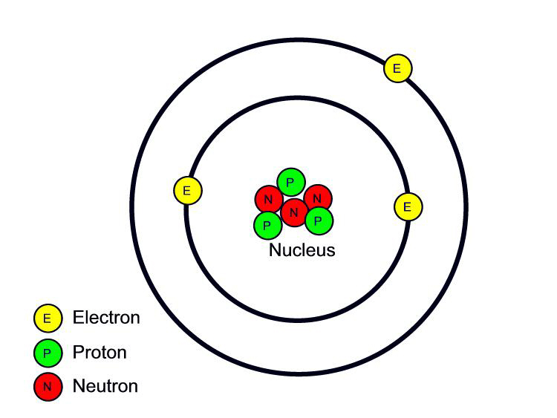
What are neutral atoms?
Atoms that have no overall electrical charge because they have an equal number of protons and electrons.

Slide 12
What is an atomic number?
The atomic number is the number of protons in the nucleus of an atom. This determines the identity (type) of the atom.
Example: Oxygen has an atomic number of 8, while Carbon has an atomic number of 6. This means that Oxygen has 8 protons, and Carbon has 6 protons.

Slide 13
What is an atomic mass number?
Atomic mass number is the total number of protons AND neutrons in the nucleus. Atoms of the same element will always have the same number of protons, but may have different numbers of neutrons.

Slide 14
What is an isotope?
Isotopes are atoms of the same element that have a different number of neutrons. Some elements have many isotopes, while other only have a few.
How do we show that something is an isotope?
An isotope is described by the name of the element and the total number of its protons and neutrons (atomic mass number).
Ex: Chlorine-35 (name-atomic mass number)

Slide 15
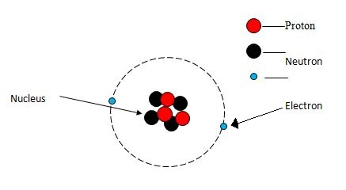
What is an ion?
An ion is an atom that has an electric charge. The charge can be positive or negative. Ions have different numbers of protons and electrons.

Slide 16
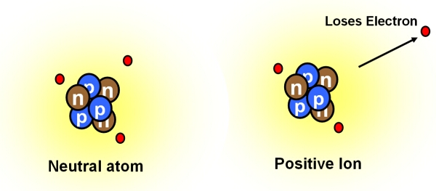
How is an ion formed?
An ion is formed when an atom gains or loses one or more electrons.
How do we show that something is an ion?
An ion is described by its name (or symbol) and charge.
Ex: Oxygen (-2) or O²⁻

Slide 17
How do I find the number of protons in an atom?
# protons = Atomic # (the number above the element’s symbol on the periodic table)
How do I find the number of neutrons in an atom?
Atomic mass number minus (-) the number of protons

Slide 18
How do I find the number of electrons in an atom?
In a neutral atom, the # of electrons is the same as the number of protons.
In an ion (with a positive or negative charge), the number of electrons is different from the number of protons. To find the number of electrons, subtract the charge from the number of protons the atom has
# protons – charge = # electrons

